Slide 1
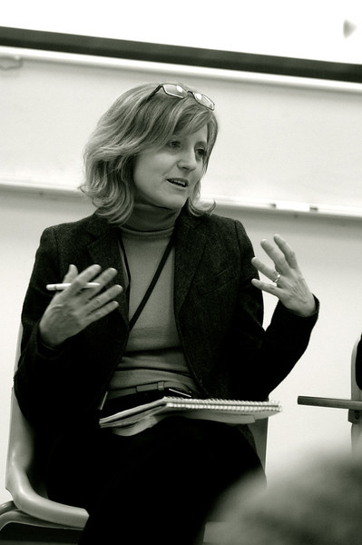
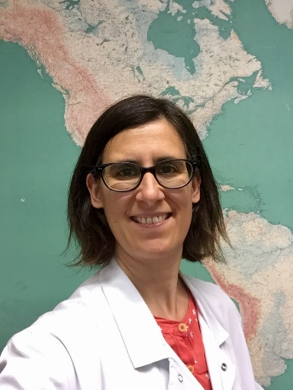
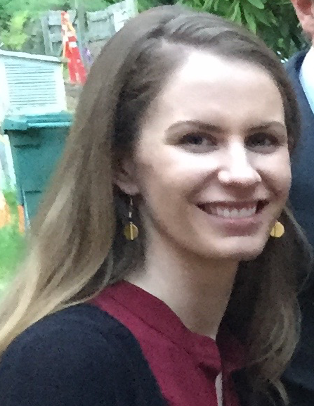
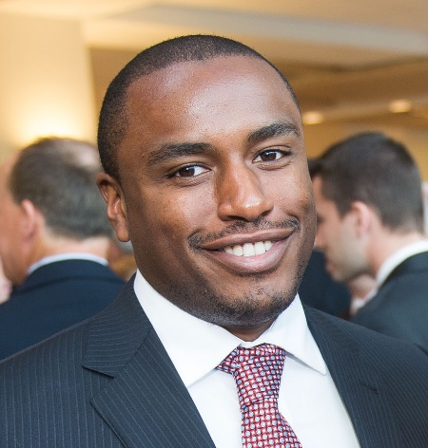
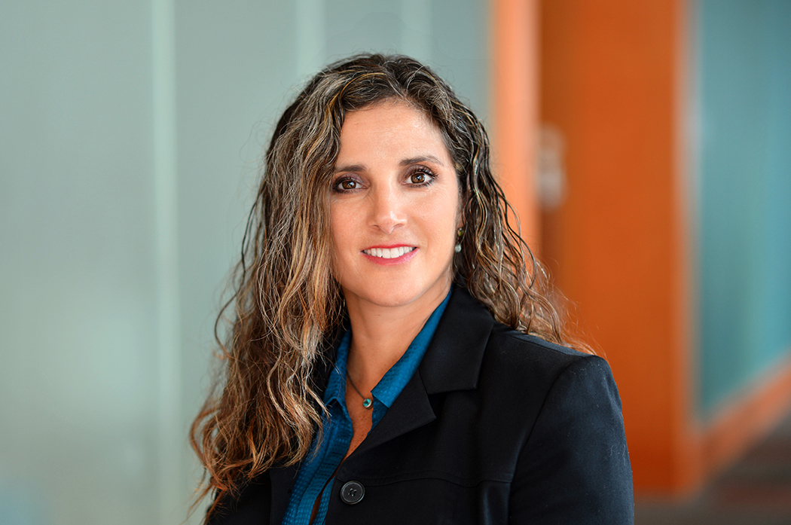
The IAS TB/HIV Research Prizes are awarded to:
Jennifer Zelnick
Justin Jones
Nathalie De Castro
Lelia Chaisson
Anna Mandalakas
Severe adherence challenges in the treatment of multi- and extensively drug resistant tuberculosis and HIV: Electronic dose monitoring and mixed methods to identify and characterize high-risk subpopulations
Community-based case finding for tuberculosis & HIV integrated with non-communicable diseases in KwaZulu-Natal, South Africa
Virologic efficacy of raltegravir vs. efavirenz-based antiretroviral treatment in HIV1-infected adults with tuberculosis: W48 results of the ANRS 12300 Reflate TB2 trial
CD4 count-based guidelines for tuberculin skin testing and tuberculosis preventive therapy in people living with HIV
ART initiation within 8 weeks of TB treatment Leads to superior TB outcomes in ART-naïve children and adolescents living with HIV: Results from six high TB/HIV burden countries

